Slide 1
Science 8--Chapter 2
Review for Test!

Slide 2
Get Ready to Read

Slide 3
Place a C after each statement that is correct or an I for those that are incorrect.

Slide 4
1. You pull on objects around you with the force of gravity.

Slide 5
2. Friction can act between two unmoving, touching surfaces.

Slide 6
3. Forces acting on an object cannot be added.

Slide 7
4. A moving object will stop if no forces act on it.

Slide 8
5. When an object’s speed increases, the object accelerates.

Slide 9
6. If an object’s mass increases, its acceleration also increases if the net force acting on the object stays the same.

Slide 10
7. If objects collide, the object with more mass applies more force.

Slide 11
8. Momentum is a measure of how hard it is to stop a moving object.

Slide 12
1. You pull on objects around you with the force of gravity.

Slide 13
Correct
1. You pull on objects around you with the force of gravity.
Gravity is an attractive force that exists between all objects that have mass.

Slide 14
2. Friction can act between two unmoving, touching surfaces.

Slide 15
Correct
2. Friction can act between two unmoving, touching surfaces.
Static friction is a force that opposes the movement of two unmoving, touching surfaces.

Slide 16
3. Forces acting on an object cannot be added.

Slide 17
Incorrect
3. Forces acting on an object cannot be added.
Forces can be added. The net force is the combination of all the forces on an object.

Slide 18
4. A moving object will stop if no forces act on it.

Slide 19
Incorrect
4. A moving object will stop if no forces act on it.
If no forces are applied to a moving object, the object will continue to move at the same speed and in the same direction.

Slide 20
5. When an object’s speed increases, the object accelerates.

Slide 21
Correct
5. When an object’s speed increases, the object accelerates.
An object accelerates when it experiences a change in speed, direction, or both.

Slide 22
6. If an object’s mass increases, its acceleration also increases if the net force acting on the object stays the same.

Slide 23
Incorrect
6. If an object’s mass increases, its acceleration also increases if the net force acting on the object stays the same.
Assuming the net force on an object is constant, if the mass of the object increases, its acceleration decreases.

Slide 24
7. If objects collide, the object with more mass applies more force.

Slide 25
Incorrect
7. Mammals evolved after dinosaurs became extinct.
If objects collide, the object with more mass applies more force.

Slide 26
8. Momentum is a measure of how hard it is to stop a moving object.

Slide 27
Correct
8. Momentum is a measure of how hard it is to stop a moving object.
It is the product of an object’s mass and velocity.

Slide 28
Science 8--Chapter 2
Lesson 1-Vocabulary

Slide 29
force

Slide 30
force
a push or pull on an object

Slide 31
contact force

Slide 32
contact force
a push or pull on an object by another object that is touching it

Slide 33
noncontact force

Slide 34
noncontact force
a force one object can apply to another object without touching it

Slide 35
gravity

Slide 36
gravity
attractive force that exists between all objects that have mass

Slide 37
mass

Slide 38
mass
amount of matter in an object

Slide 39
weight

Slide 40
weight
gravitational force exerted on an object

Slide 41
friction

Slide 42
friction
force that resists the motion of two surfaces that are touching

Slide 43
significant

Slide 44
significant
important; momentous

Slide 45
static

Slide 46
static
at rest or having no motion

Slide 47
law of universal gravitation

Slide 48
law of universal gravitation
all objects are attracted to each by a gravitational force

Slide 49
newton

Slide 50
newton
unit of force or weight

Slide 51
static friction

Slide 52
static friction
a force that prevents objects from moving, or keeps them at rest

Slide 53
sliding friction

Slide 54
sliding friction
friction that opposes motion of surfaces sliding past each other

Slide 55
fluid friction

Slide 56
fluid friction
friction between a surface and a fluid

Slide 57
air resistance

Slide 58
air resistance
fluid friction between a surface and air

Slide 59
lubricant

Slide 60
lubricant
substance that reduces friction

Slide 61
Science 8-Chapter 2
Lesson 2 Vocabulary

Slide 62
net force

Slide 63
net force
combination of all the forces acting on an object

Slide 64
balanced forces

Slide 65
balanced forces
combined forces form a net force of zero

Slide 66
unbalanced forces

Slide 67
unbalanced forces
combined forces that form a net force that is not zero

Slide 68
Newton’s first law of motion

Slide 69
Newton’s first law of motion
the motion of an object does not change if the net force on an object is zero

Slide 70
inertia

Slide 71
inertia
tendency of an object to resist a change in its motion

Slide 72
reference direction

Slide 73
reference direction
given direction from a starting point to describe an object’s position

Slide 74
Science 8-Chapter 2
Lesson 3 Vocabulary

Slide 75
Newton’s Second Law of Motion

Slide 76
Newton’s Second Law of Motion
acceleration is equal to the net force exerted on the object divided by the object’s mass

Slide 77
circular motion

Slide 78
circular motion
any motion in which an object is moving along a curved path

Slide 79
centripetal force

Slide 80
centripetal force
a force in circular motion that acts perpendicular to the direction of motion toward the center of the circle

Slide 81
velocity

Slide 82
velocity
speed in a certain direction

Slide 83
acceleration

Slide 84
acceleration
a change in velocity over time

Slide 85
Science 8-Chapter 2
Lesson 4 Vocabulary

Slide 86
Newton’s third law of motion

Slide 87
Newton’s third law of motion
for every action there is an equal and opposite reaction

Slide 88
force pair

Slide 89
force pair
forces that two objects apply to each other

Slide 90
momentum

Slide 91
momentum
measure of how hard it is to stop a moving object

Slide 92
law of conservation of momentum

Slide 93
law of conservation of momentum
total momentum of a group of objects remains the same unless outside forces act on the objects

Slide 94
elastic collision

Slide 95
elastic collision
collision where colliding objects bounce off each other

Slide 96
elastic collision

Slide 97
inelastic collision
collision where objects collide and stick together

Slide 98
What is inertia?

Slide 99
What is inertia?
tendency of an object to resist a change in its motion

Slide 100
What is mass?

Slide 101
What is mass?
amount of matter in an object

Slide 102
What is centripetal force?

Slide 103
What is centripetal force?
a force in circular motion that acts perpendicular to the direction of motion toward the center of the circle

Slide 104
What is a force pair?

Slide 105
What is a force pair?
forces that two objects apply to each other

Slide 106
What is momentum?

Slide 107
What is momentum?
measure of how hard it is to stop a moving object

Slide 108
What is force?

Slide 109
What is force?
a push or pull on an object

Slide 110
What is contact force?

Slide 111
What is contact force?
a push or pull on an object by another object that is touching it

Slide 112
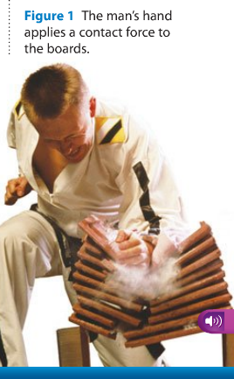
Examples of contact force

Slide 113
Examples of contact force
Musician hitting piano keys
Athlete hitting a ball with a bat

Slide 114
What is non contact force?

Slide 115
What is non contact force?
a force one object can apply to another object without touching it

Slide 116
Examples of noncontact force?
electrical force
gravity
magnetic force

Slide 117
What are balanced forces?

Slide 118
What are balanced forces?
combined forces form a net force of zero

Slide 119
Examples of balanced forces?

Slide 120
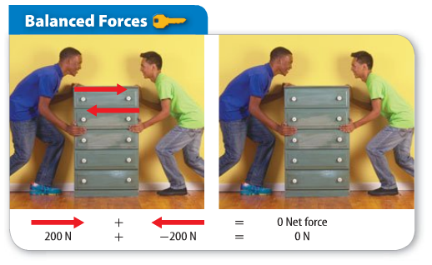
Examples of balanced forces?

Slide 121
Examples of balanced forces?

Slide 122
What are unbalanced forces?

Slide 123
What are unbalanced forces?
combined forces that form a net force that is not zero

Slide 124
Examples of unbalanced forces?

Slide 125
What is net force?

Slide 126
What is net force?
combination of all the forces acting on an object

Slide 127
How do we figure net force?

Slide 128
How do we figure net force?

Slide 129
What is Newton’s First Law of Motion?
combination of all the forces acting on an object

Slide 130
What is Newton’s First Law of Motion?
the motion of an object does not change if the net force on an object is zero

Slide 131
Also
One more definition!

Slide 132
What is Newton’s First Law of Motion?
an object in motion stays in motion; an object at rest stays at rest unless an outside force acts upon the object

Slide 133
Examples of Newton’s First Law

Slide 134
Examples of Newton’s First Law
ball rolling out of shoe box
penny falling in the cup
Heinrich flying forward off the Tonka truck
WHY?

Slide 135
What is Newton’s Second Law of Motion?

Slide 136
What is Newton’s Second Law of Motion?
acceleration is equal to the net force exerted on the object divided by the object’s mass

Slide 137
Examples of Newton’s Second Law

Slide 138
Examples of Newton’s Second Law
baseball in the box—When does it move faster?

Slide 139
What is Newton’s Third Law of Motion?

Slide 140
What is Newton’s Third Law of Motion?
for every action there is an equal and opposite reaction

Slide 141
Examples of Newton’s Third Law

Slide 142
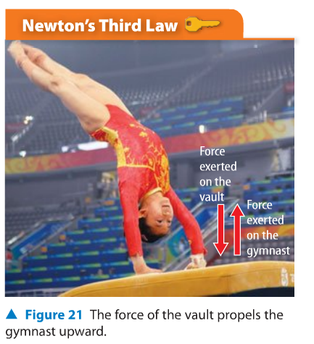
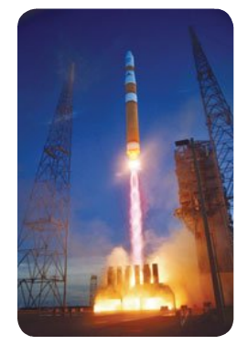
Examples of Newton’s Third Law
The balloon goes forward—the ping pong ball goes backward.

Slide 143
What is gravity?

Slide 144
What is gravity?
attractive force that exists between all objects that have mass

Slide 145
How does gravity affect objects?

Slide 146
How does gravity affect objects?
Gravity is an attractive force.

Slide 147
What two factors affect gravity?

Slide 148
What two factors affect gravity?
mass
distance

Slide 149
What two factors affect gravity?
Gravity is an attractive force.

Slide 150
What is friction?

Slide 151
What is friction?
force that resists the motion of two surfaces that are touching

Slide 152
What are the three types of friction we studied in this chapter?

Slide 153
What are the three types of friction we studied in this chapter?
static friction
sliding friction
fluid friction

Slide 154
What is static friction?

Slide 155
What is static friction?
a force that prevents objects from moving, or keeps them at rest

Slide 156
Example of static friction

Slide 157
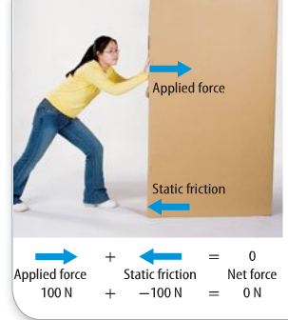
Example of static friction
Static friction prevents the box from moving

Slide 158
What is sliding friction?

Slide 159
What is sliding friction?
friction that opposes motion of surfaces sliding past each other

Slide 160
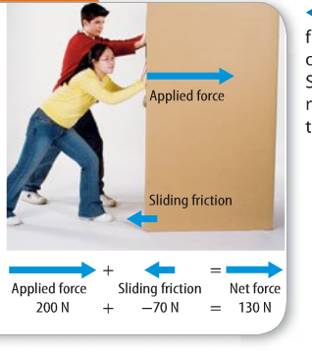
Example of sliding friction
Sliding friction slows the motion of the box.

Slide 161
What is fluid friction?

Slide 162
What is fluid friction?
friction between a surface and a fluid

Slide 163
What is fluid friction?
friction between a surface and a fluid
Note!--Any material, such as water, or air, that flows—is fluid friction.

Slide 164
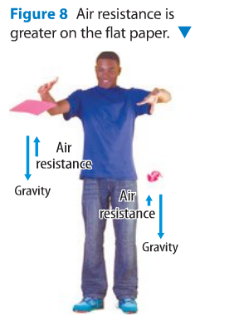
Example of fluid friction
Air resistance is greater on the flat paper.
Air resistance is
fluid friction

Slide 165
How is friction stopped?

Slide 166
How is friction stopped?
Lubricant
Reducing surface area

Slide 167
What happens to objects at rest if the net force is zero?

Slide 168
What happens to objects at rest if the net force is zero?
The object does not move. It stays at rest.

Slide 169
What happens to objects at rest if the net force is NOT zero?

Slide 170
What happens to objects at rest if the net force is NOT zero?
The object moves.

Slide 171
What is the formula for figuring acceleration?
Force = mass (acceleration)
a = $\frac{mass}{force}$
What do you want to solve for?
Substitute numbers in

Slide 172
What is the formula for figuring momentum?
momentum = mass (velocity)
p = mv
What do you want to solve for?
Substitute numbers in!

Slide 173
Questions on the balloon lab!

Slide 174
Science Investigations

Slide 175
The Rock Cycle

Slide 176
Forces and Motion

Slide 177
END!

